Slide 1
Min 15-30: Moodle Quiz (7 questions, 25 min)
Learning Objectives (Moodle Quiz at Min 45 on Géron Ch8+9):
Understand the necessity of reducing dimensionality for big datasets
Know at least two approaches for dimensionality reduction
Understand the steps of Principal Component Analysis
Distinguish clustering from supervised classification
Know how to implement the K-means algorithm and select the number of clusters
Know how to implement Gaussian mixture models and how to detect anomalies
Notes:
Questions?
Not graded

Slide 2
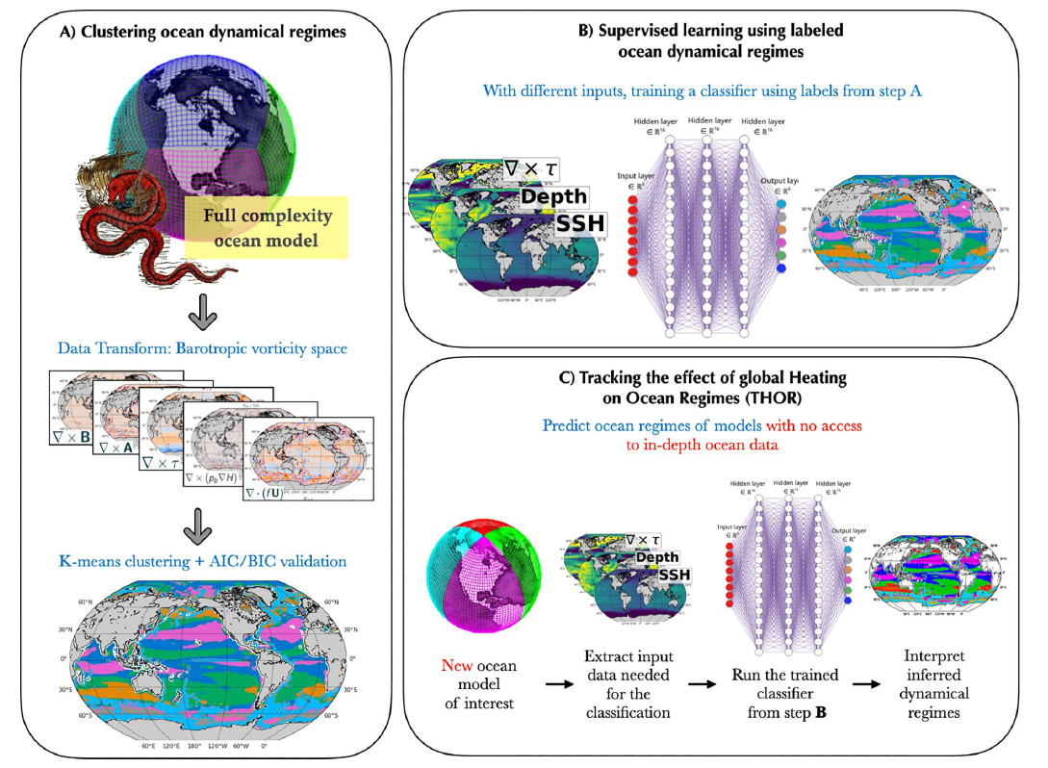
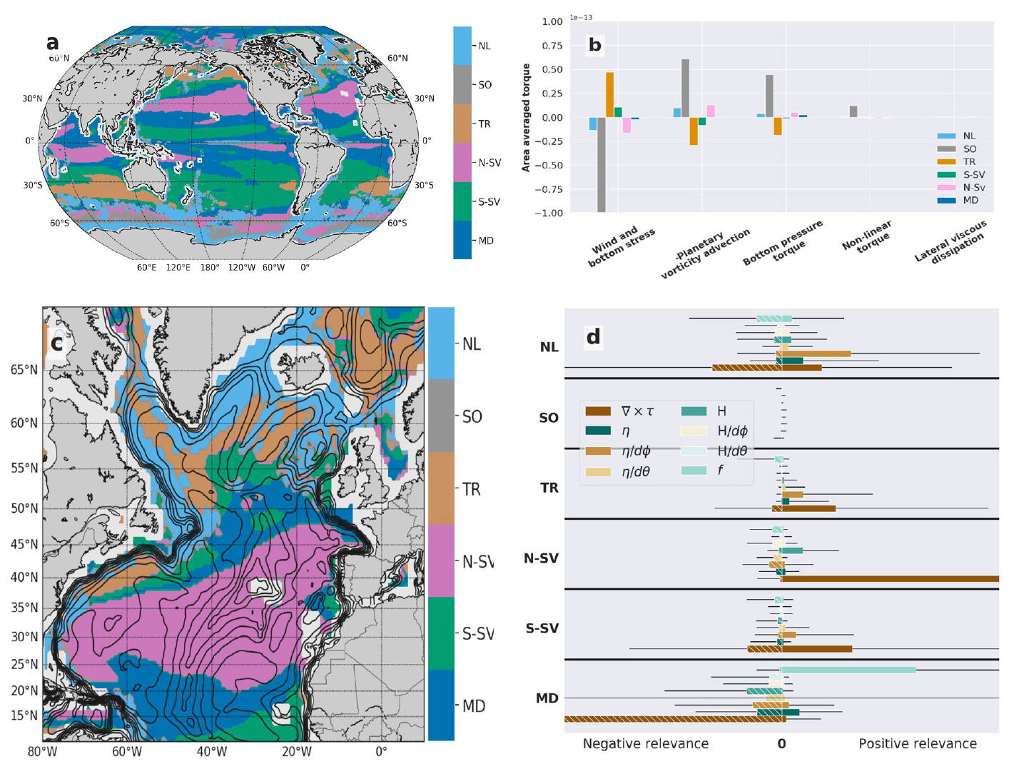

Slide 3
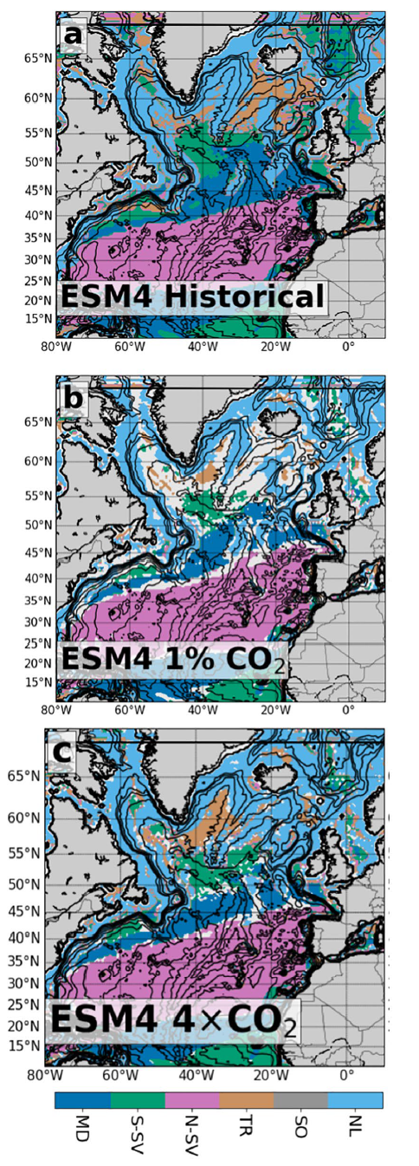
How is this dynamical regime expected to change in response to an increase in the atmospheric carbon dioxide concentration? Why?

Slide 4

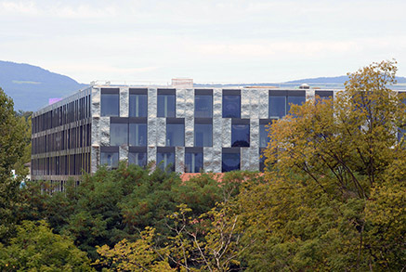
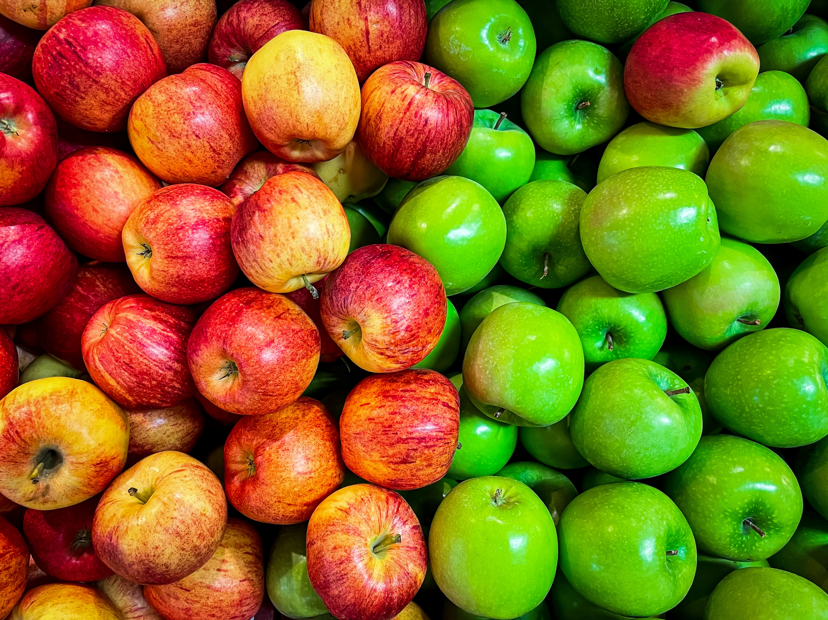
Min 60-75: Break

Slide 5


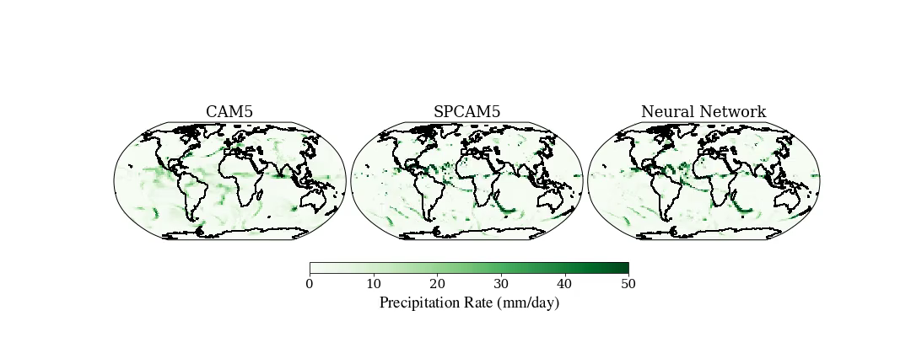
ML for Earth & Env Sci (Week 4, SA2024)
How can we emulate complex, nonlinear, high-dimensional environmental processes with machine learning?
Source: Mooers et al. (2021)
Notes:
First we see the SST, highlighting the fine-scale eddies and filaments present in the simulation.
Then we see density transformation by surface heat fluxes.
Finally we see density transformation by near-surface lateral mixing.

Slide 6
Min 75-105: Neural Networks for High-Dimensional, Nonlinear Processes
Learning Objectives (Géron Ch10 & Ch11):
Define an artificial neural network
Understand activation functions
Understand the steps & best practices to build an artificial neural network
Know the main hyperparameters defining a neural network’s architecture
Know the main hyperparameters controlling the training of a neural network

Slide 7
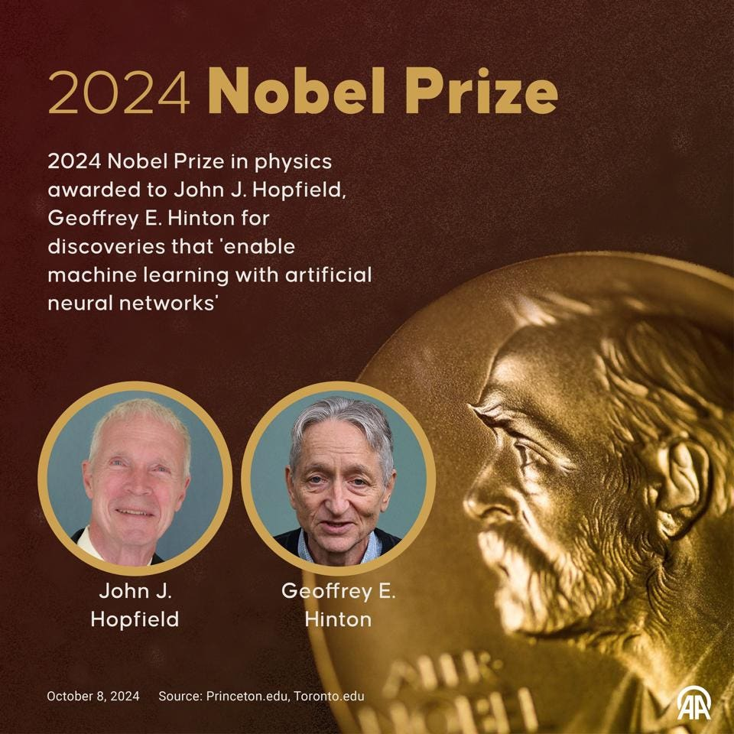
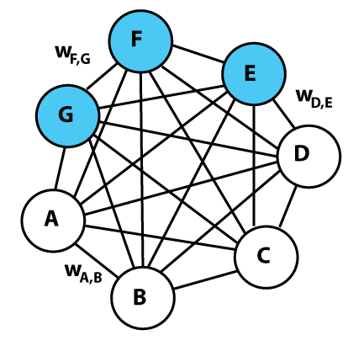
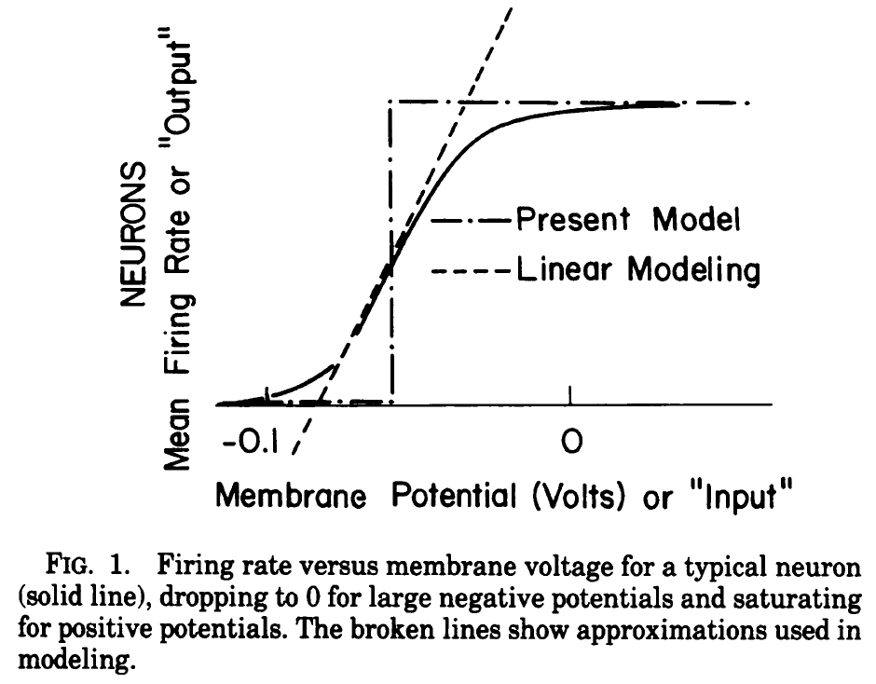
Sources: Forbes, Wikipedia (Boltzmann machine), Hopfield (1982)
Boltzmann machine = Stochastic neural network where nodes make probabilistic decisions about being on or off
Hopfield network = recurrent neural network that can store and recall patterns

Slide 8
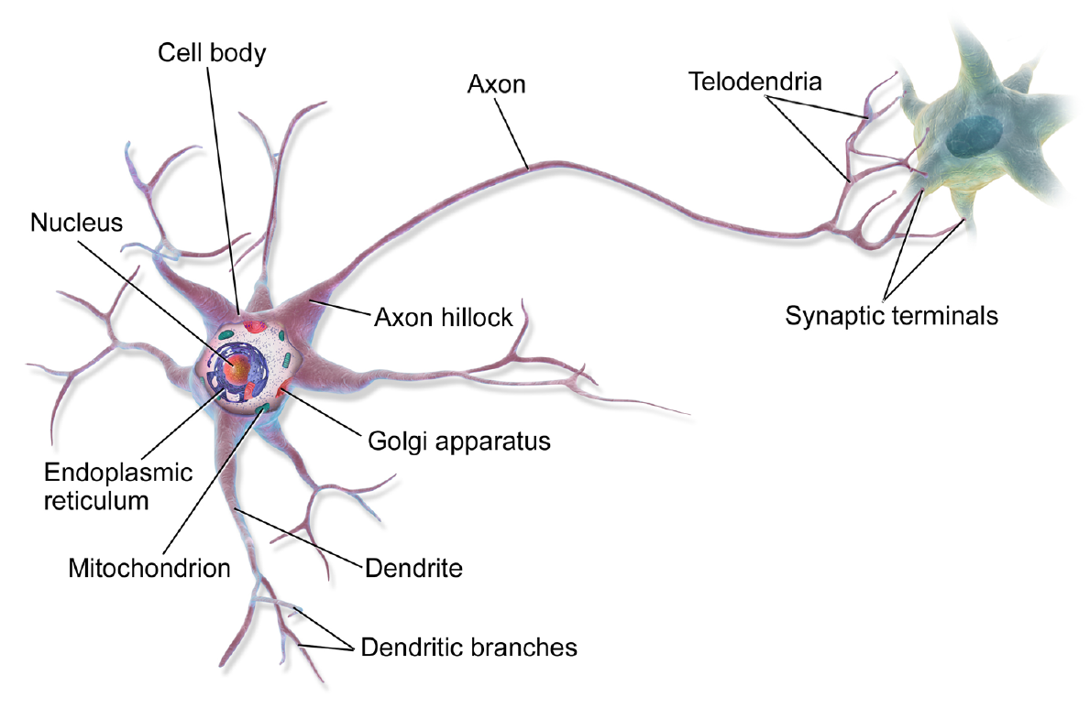
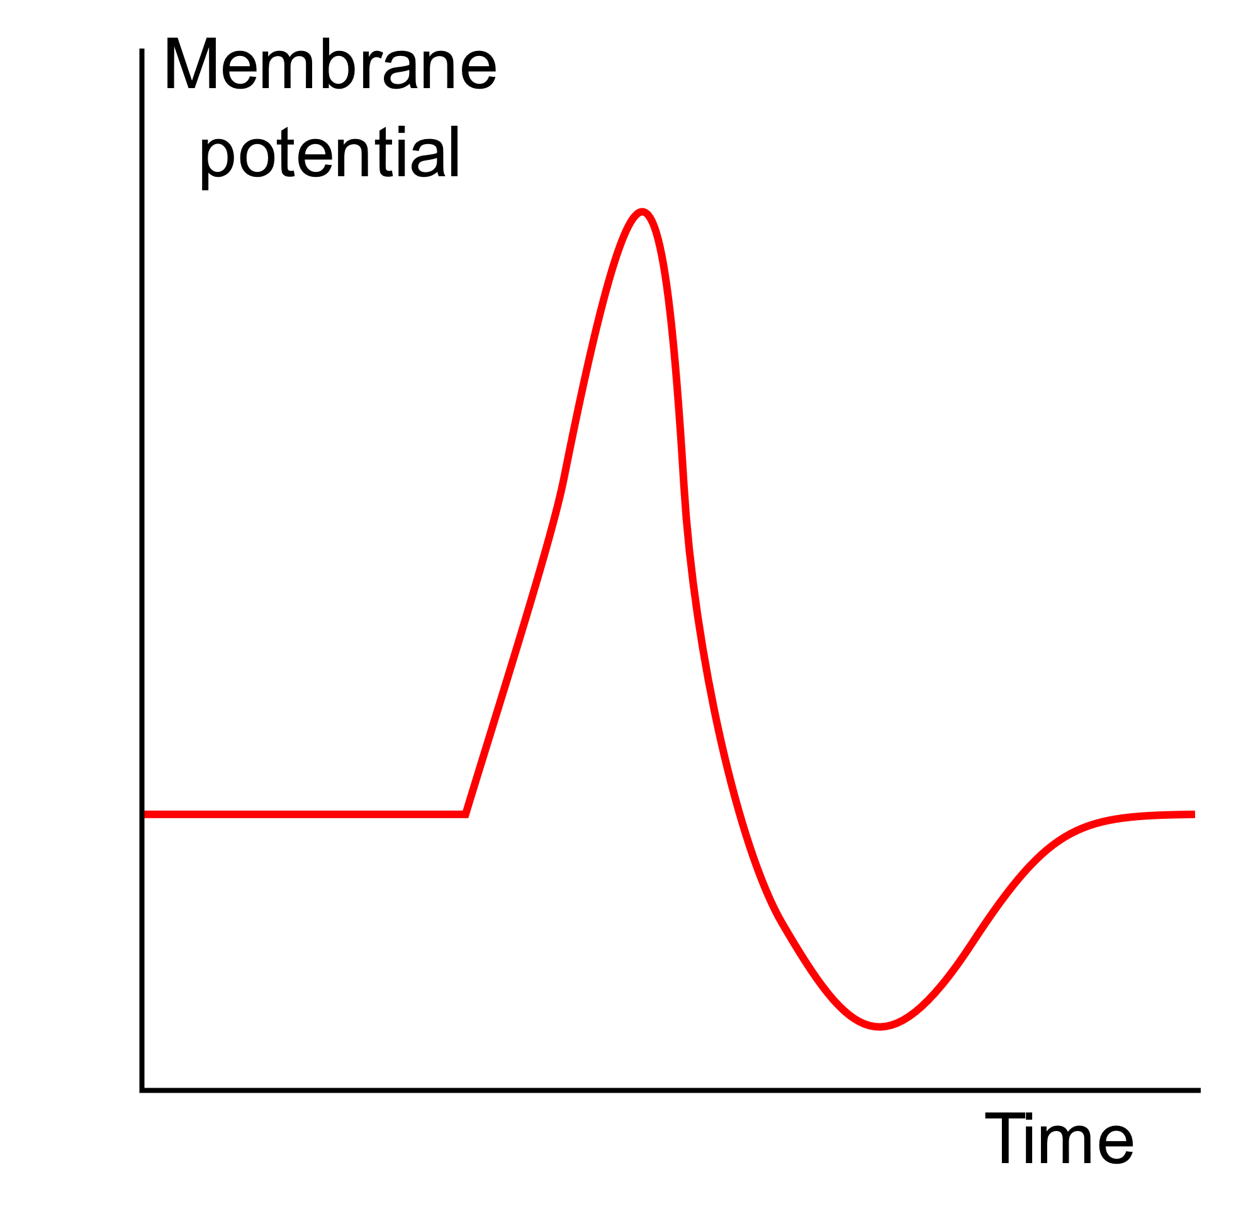
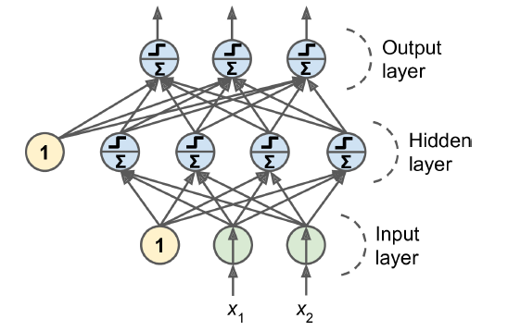
From biological to artificial neural networks
Action Potential
Source: https://commons.wikimedia.org/w/index.php?curid=44114666

Slide 9
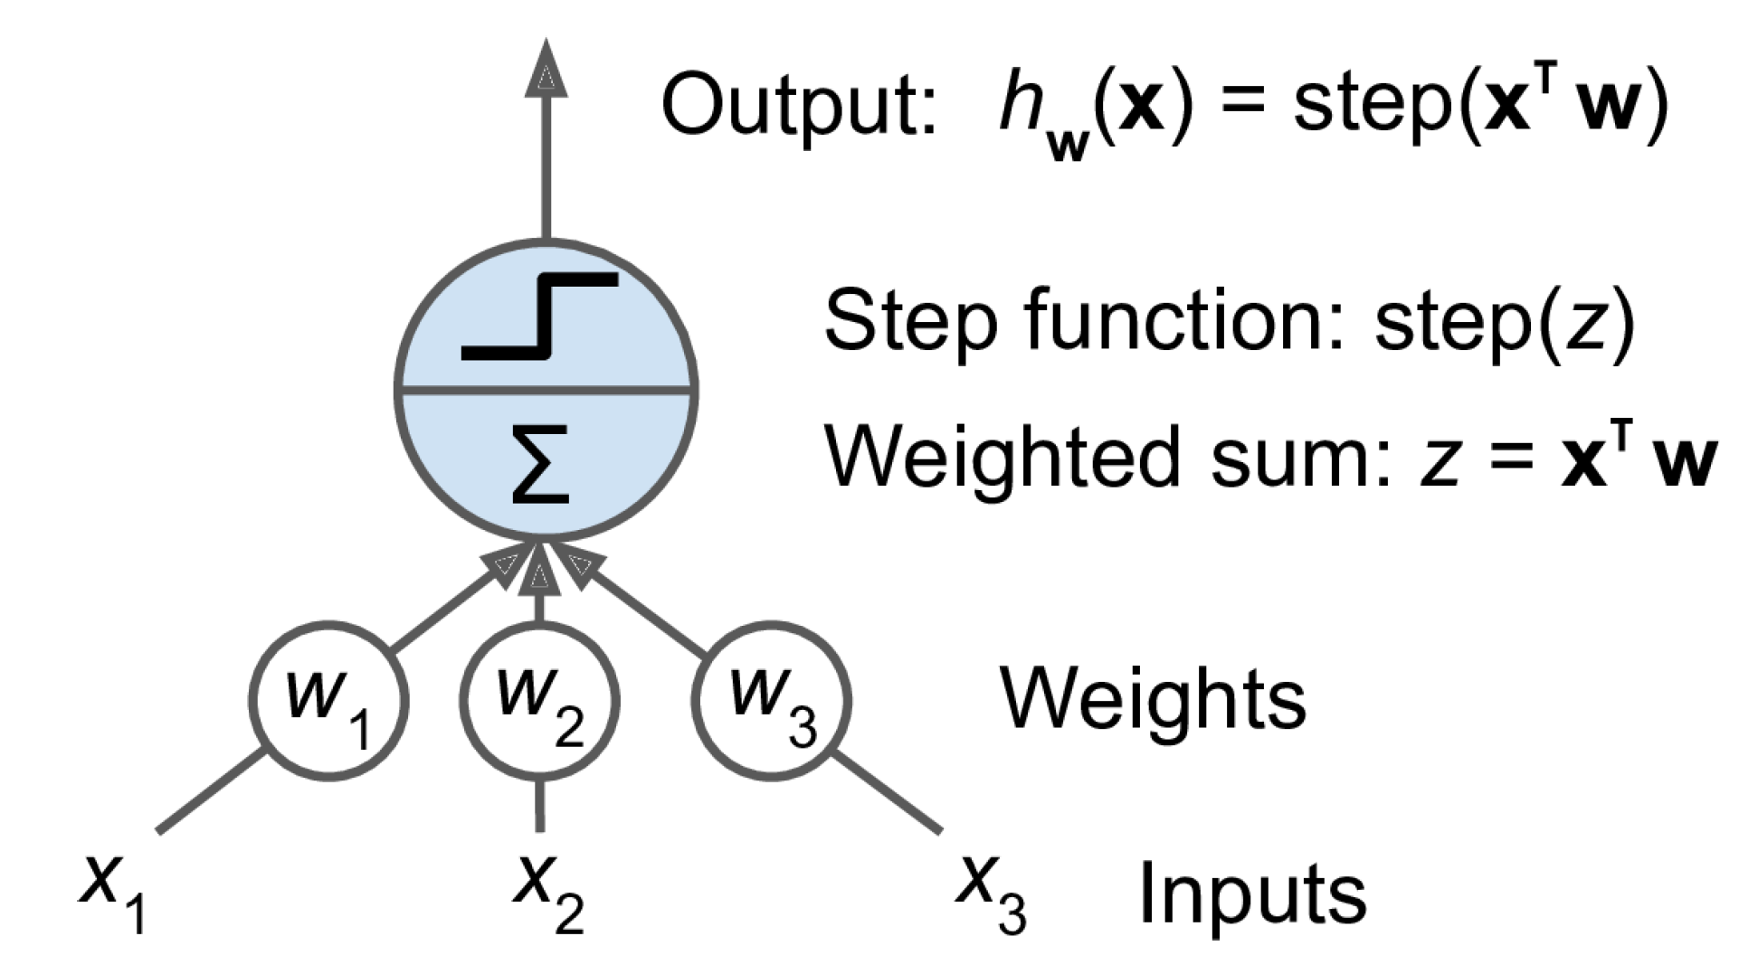
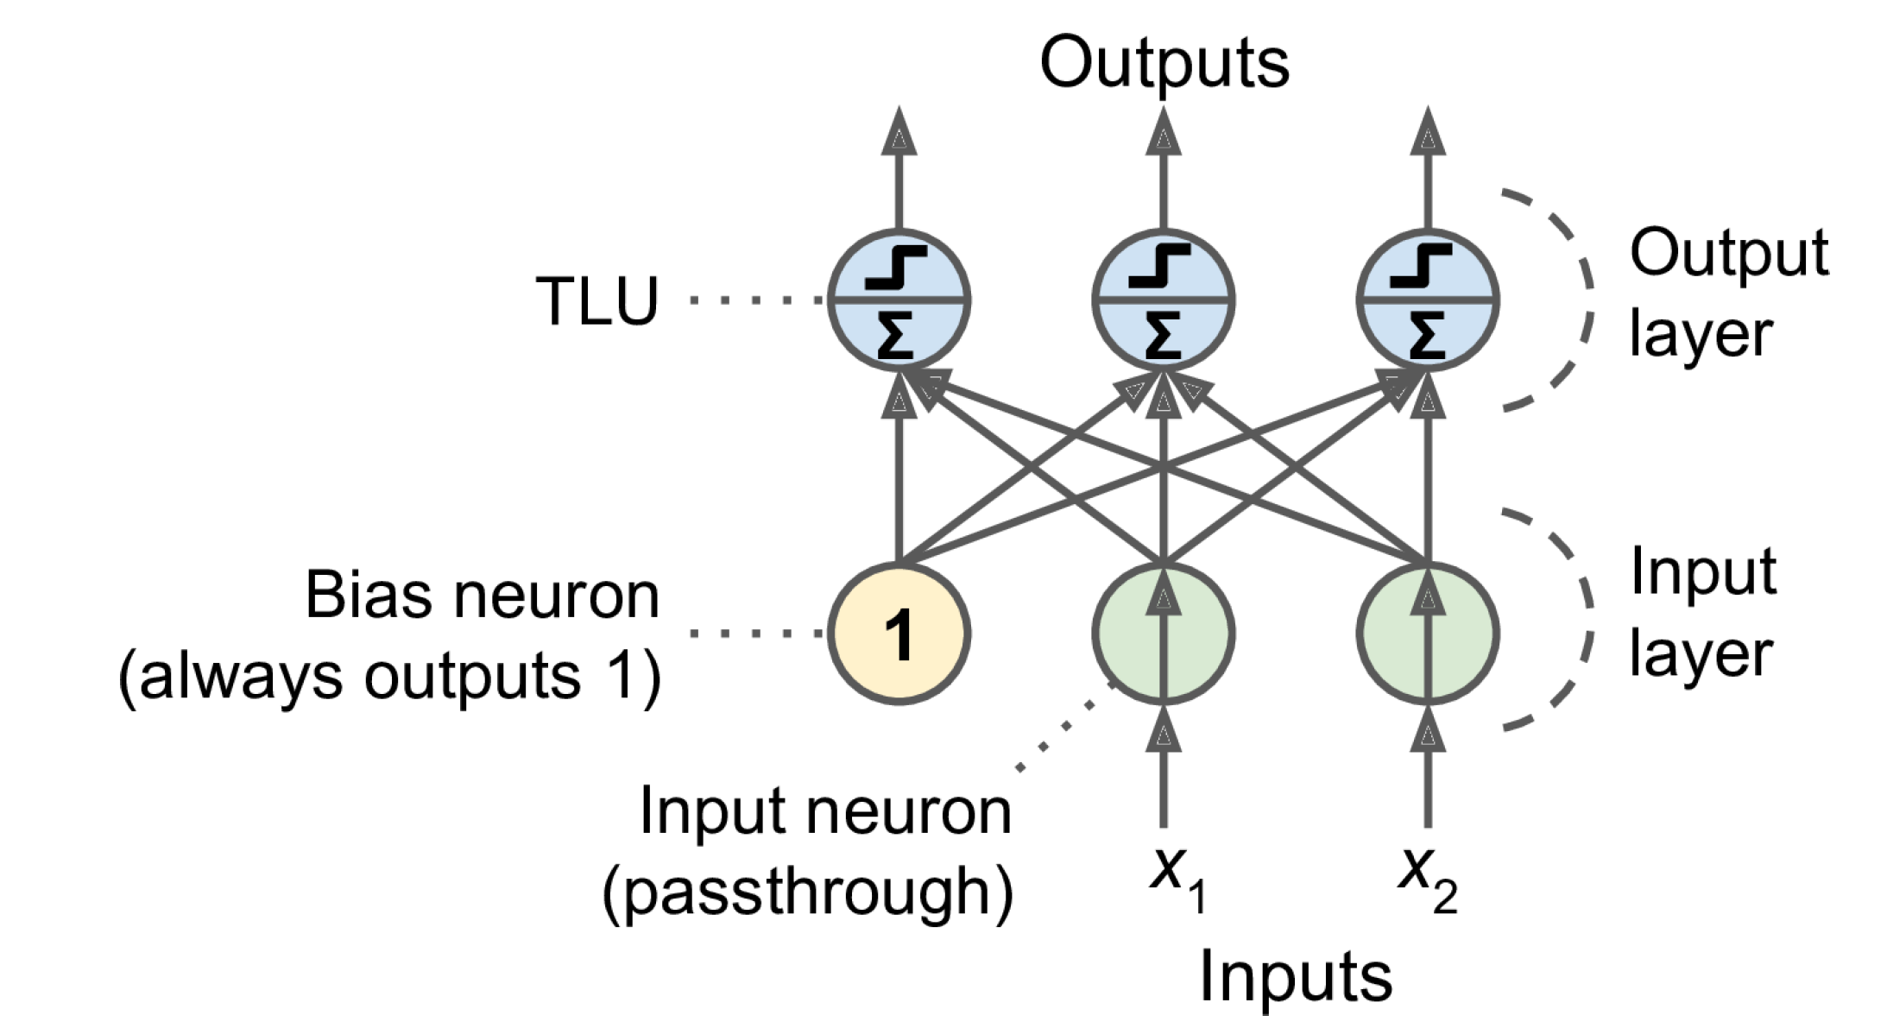
From the perceptron to a fully connected layer
3 inputs, 1 output
2 inputs, 3 outputs
Notes:
TLU = Threshold logic unit

Slide 10
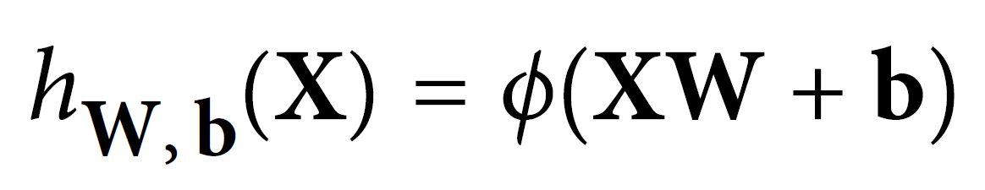
From the perceptron to a fully connected layer
Input Vector
Weight Matrix
Activation Function
2 inputs, 3 outputs
Bias Vector (Intercept)

Slide 11
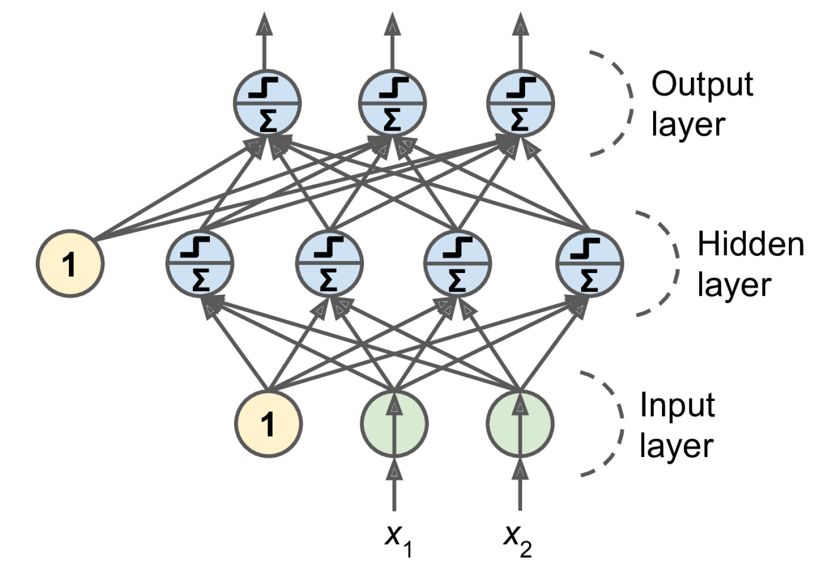
From fully connected layer to Multilayer Perceptron
Notes:
1 layer = similar to logistic regression
2 layers = shallow neural network
Deep learning = 3 layers and above

Slide 12
Feedforward neural network

Slide 13
Universal Approximation Theorem: By making an artificial neural network wide enough (large W) or by making an artificial neural network deep enough (many ϕ) A neural network can represent any continuous functions
Source: Cybenko & Hornik (1989), Leshno et al. (1993), Zhou et al. (2017)

Slide 14
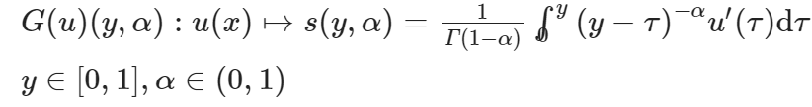
Universal Approximation Theorem: By making an artificial neural network wide enough (large W) or by making an artificial neural network deep enough (many ϕ) A neural network can represent any continuous functions
and even any nonlinear continuous operator
Source: Lu et al. (2021)

Slide 15
?
?
?
?

Slide 16


Adjusting the weights requires calculating the gradient of the loss
To calculate gradients, neural networks use automatic differentiation
Vanishing (0)/Exploding(∞)
Notes:
Vanishing gradient = Graident

Slide 17
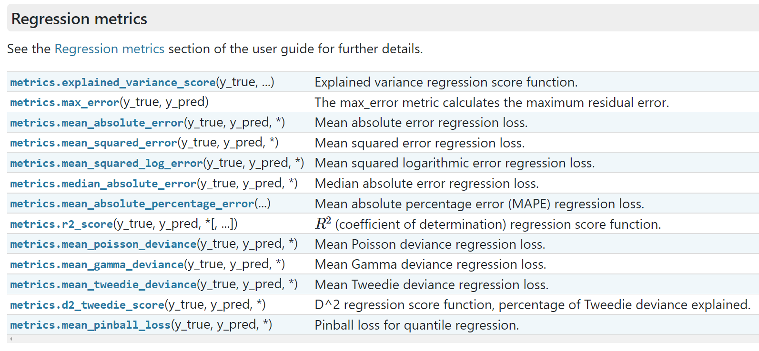
How to build a neural network in practice?
Define your problem (classification versus regression, loss function)

Slide 18
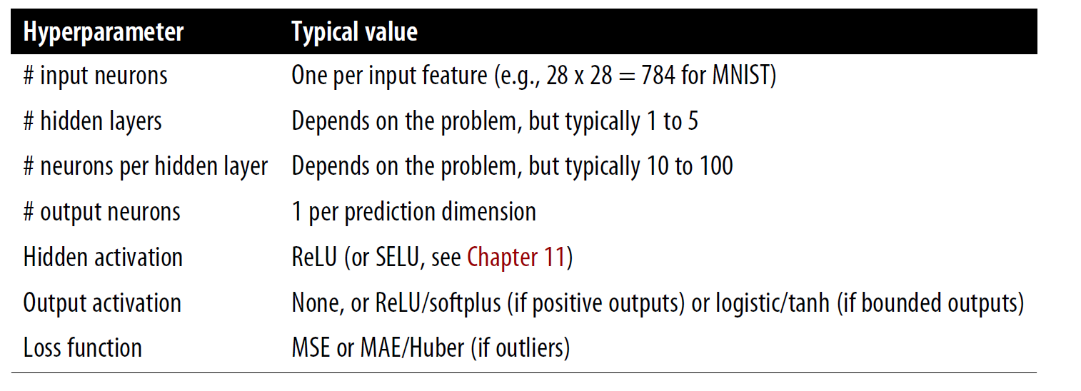
How to build a neural network in practice?
Define your problem (classification versus regression, loss function)
Pre-process the data (training/validation/test split, normalization/scaling)
Choose your architecture:

Slide 19

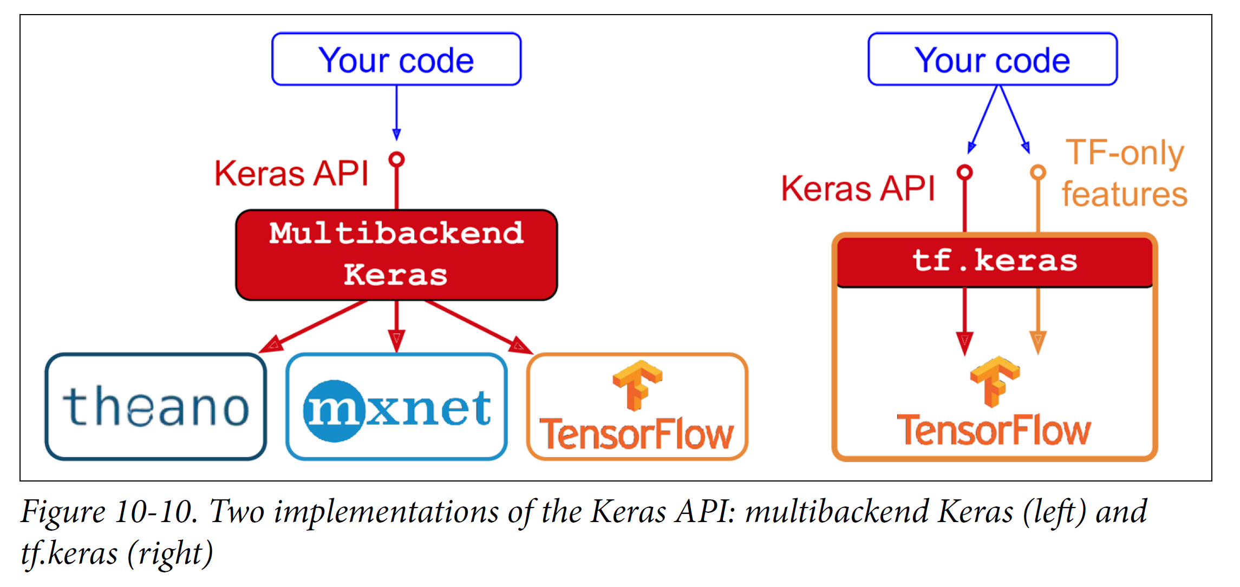
API = Application Programming Interface = Way for computer programs to communicate
≠ GUI
(Graphical User
Interface)
≠ IDE
(Integrated Development Environment)
Source: Géron
Notes:
Not ton confuse with a GUI, or Graphical User Interface, is a visual interface that allows users to interact with and control computer software through graphical elements such as windows, icons, buttons, and menus, making it easier for users to perform tasks and access features.
Integrated Development Environment (IDE) is a software application that combines various tools essential for software development into a single interface.

Slide 20
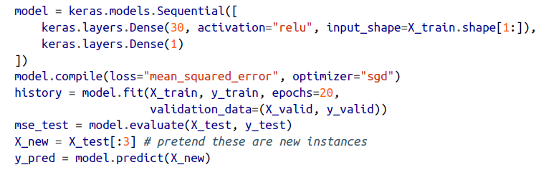
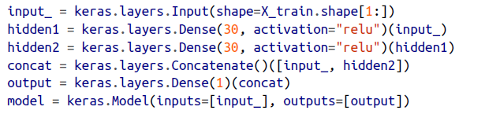
How to build a neural network in practice?
Define your problem (classification versus regression, loss function)
Pre-process the data (training/validation/test split, normalization/scaling)
Choose your architecture & implement it using sequential/functional API
Sequential API
Functional API

Slide 21
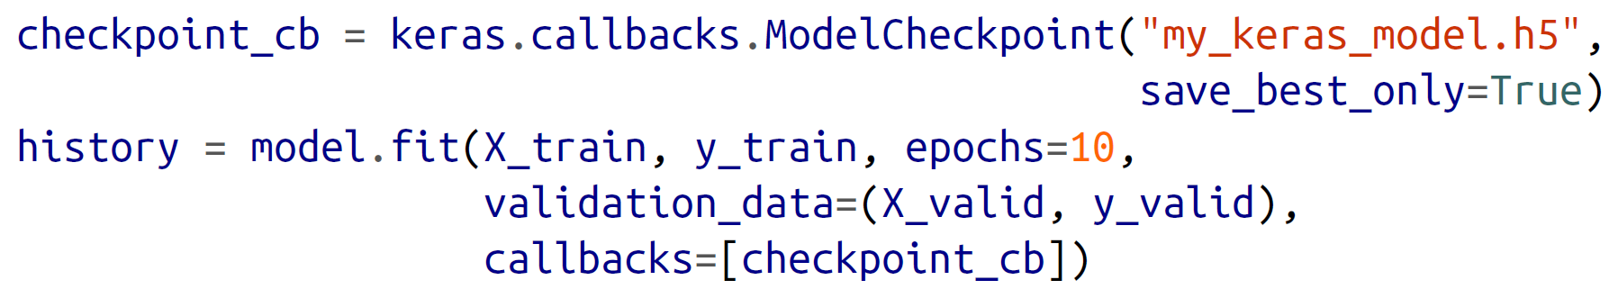
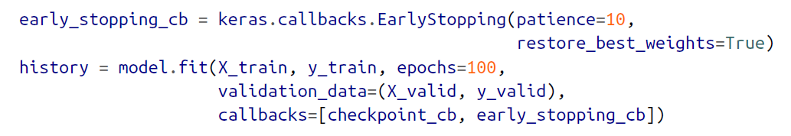
How to build a neural network in practice?
Define your problem (classification versus regression, loss function)
Pre-process the data (training/validation/test split, normalization/scaling)
Choose your architecture & implement it using sequential/functional API
Choose your training hyperparameters (learning rate, batch size, etc.)
Train your neural network on the training set
Use the validation set to optimize hyperparameters & for callbacks

Slide 22
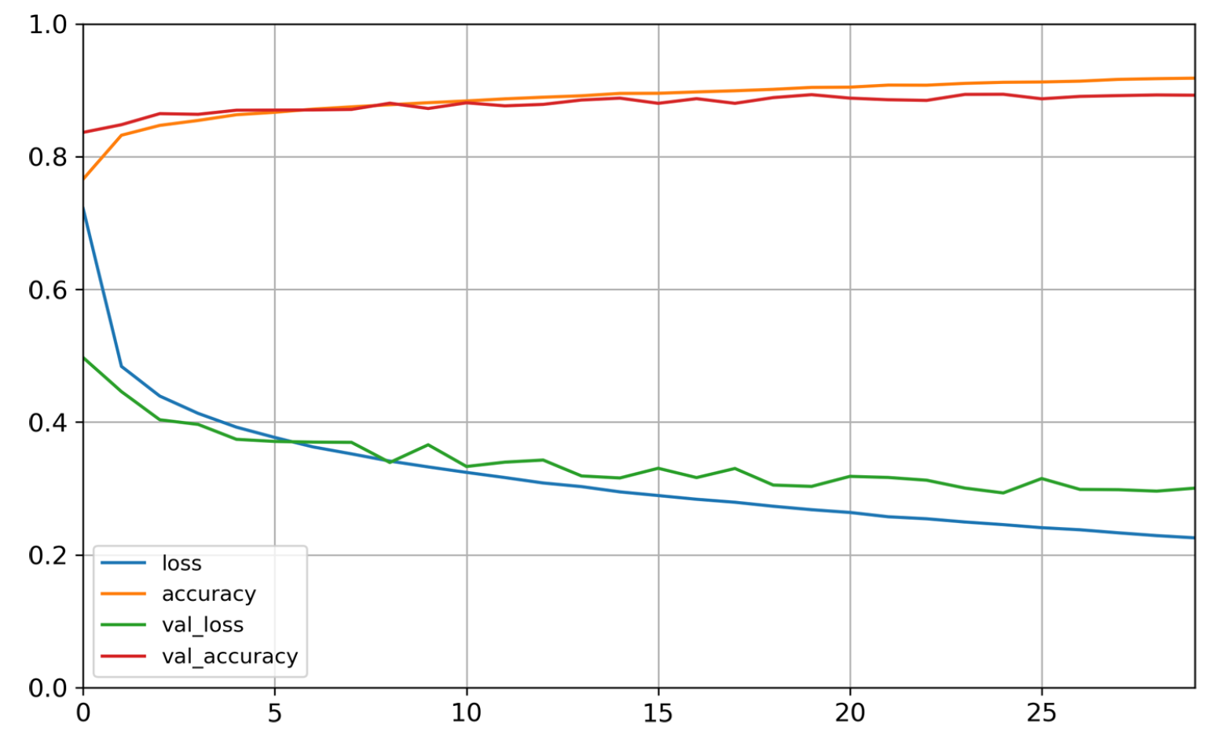
How to build a neural network in practice?
Define your problem (classification versus regression, loss function)
Pre-process the data (training/validation/test split, normalization/scaling)
Choose your architecture & implement it using sequential/functional API
Choose your training hyperparameters (learning rate, batch size)
Train your neural network on the training set
Use the validation set to optimize hyperparameters & for callbacks
#Epoch = Going through the entire training set once

Slide 23
How to build a neural network in practice?
Define your problem (classification versus regression, loss function)
Pre-process the data (training/validation/test split, normalization/scaling)
Choose your architecture & implement it using sequential/functional API
Choose your training hyperparameters (learning rate, batch size, etc.)
Train your neural network on the training set
Use the validation set to optimize hyperparameters & for callbacks (Hyperparameter optimization libraries = Hyperopt, Hyperas, Keras Tuner)
Your network is ready ☺ Evaluate it on the test set and you’re done!

Slide 24
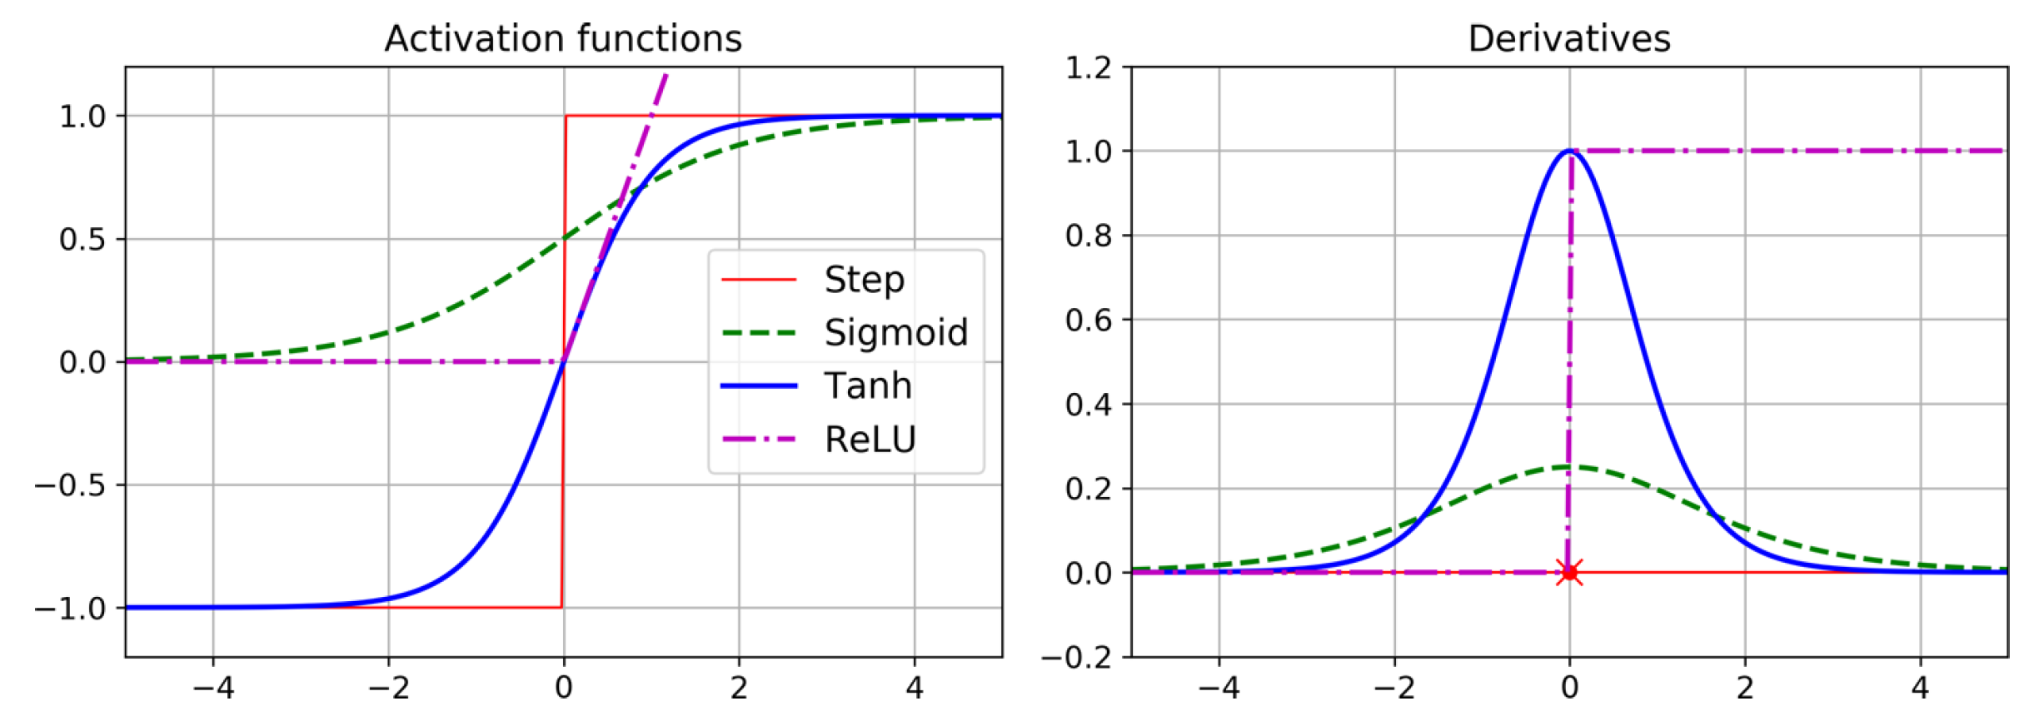

Slide 25
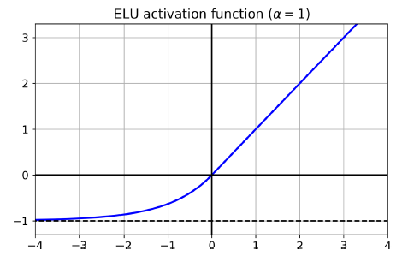
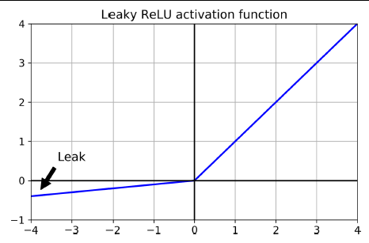
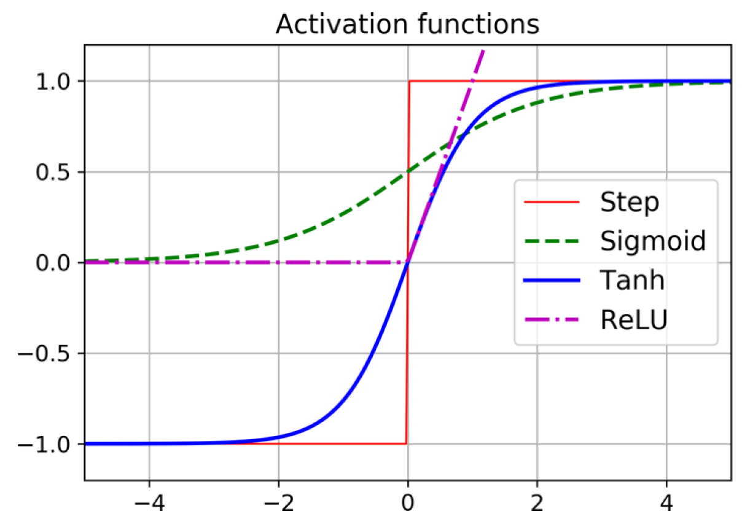
Choose activation function: SELU > ELU > Leaky ReLU > ReLU > tanh > Logistic

Slide 26
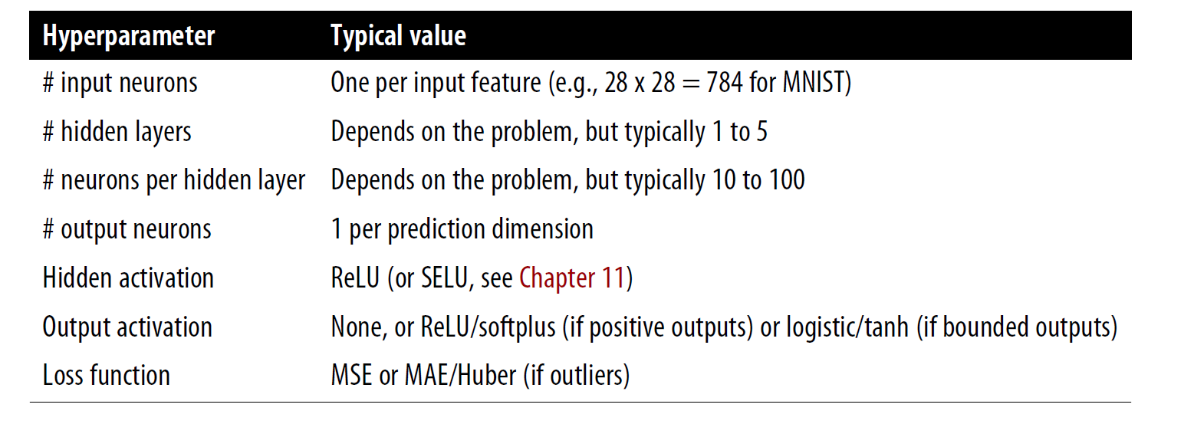
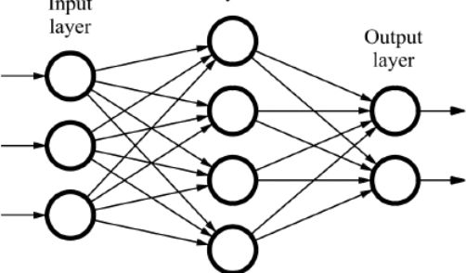
Hyperparameters related to the architecture
Smallest power of 2 to not create bottleneck (Chollet)
logistic/softmax (classification)

Slide 27

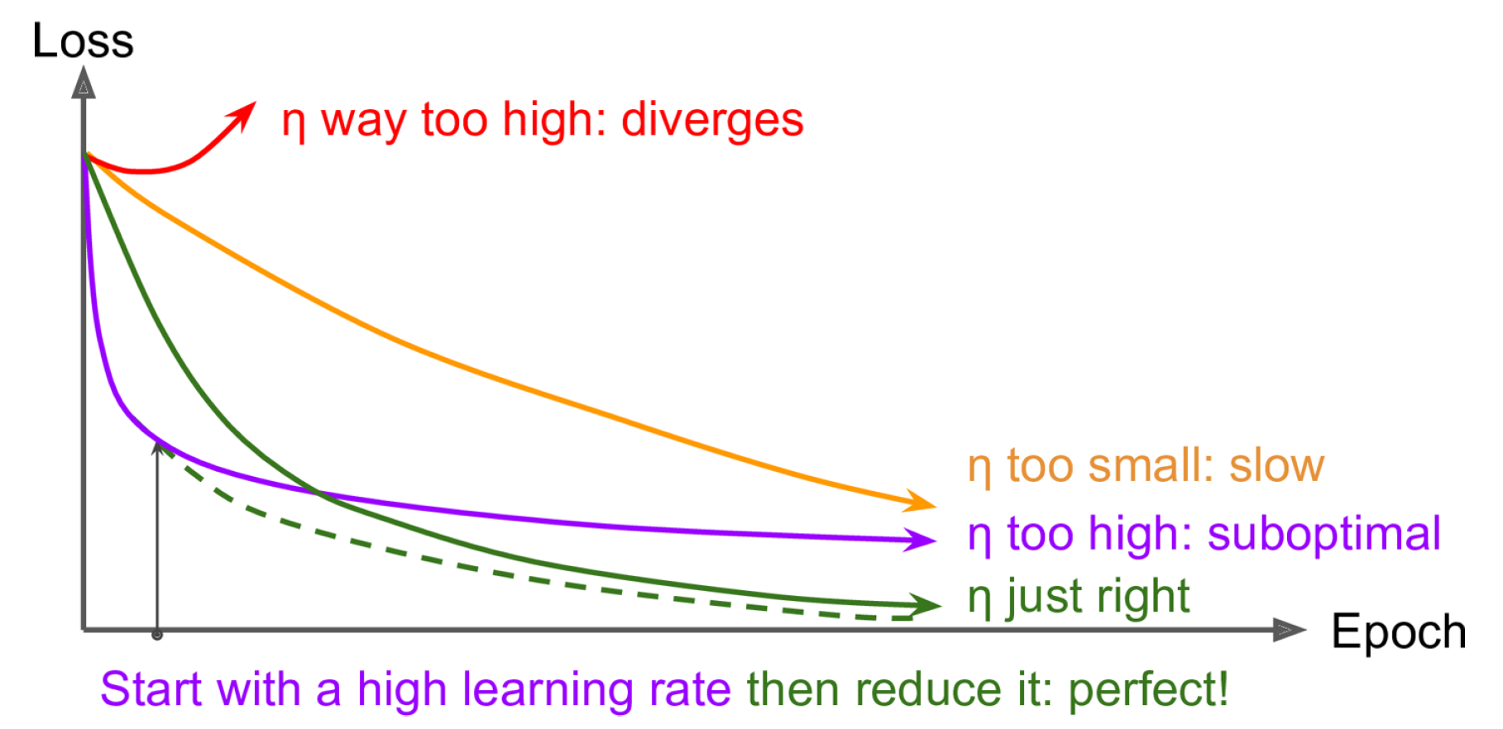
Hyperparameters related to the training
Loss function:
MSE, MAE, Huber (outliers) for reg.
Cross-entropy for classification
Batch size, Initialization of weights
Optimizer
Learning Rate
Source: towardsdatascience.com

Slide 28
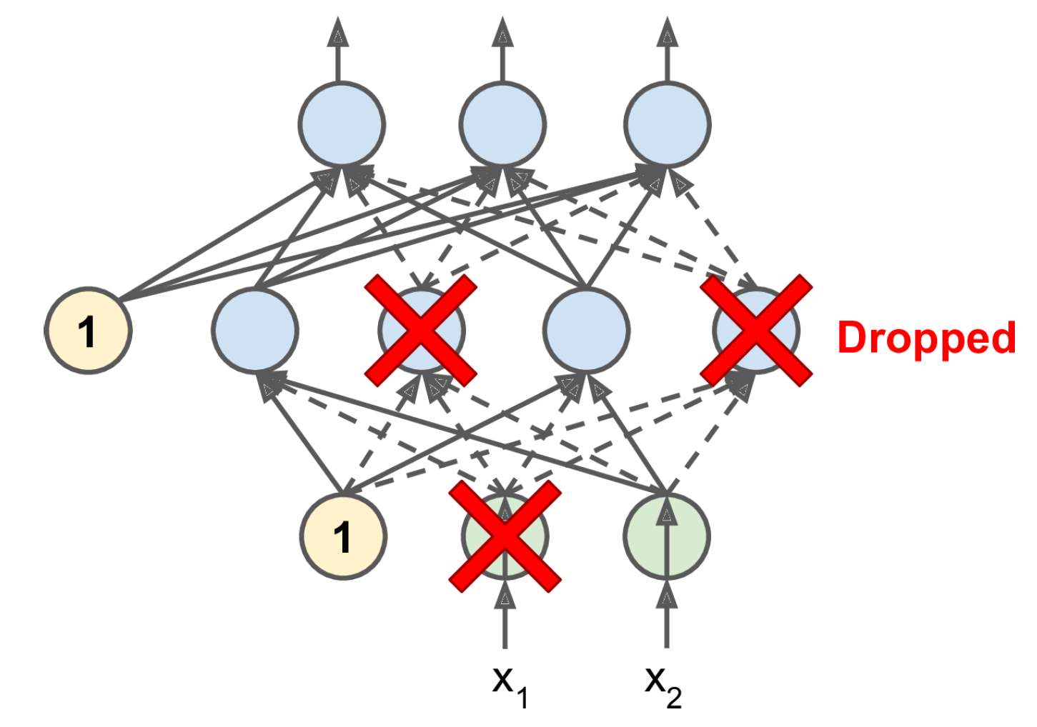
Avoiding Overfitting Through Regularization
L1/L2 regularization: Loss += |Weights,Biases| + (Weights,Biases)²
Batch normalization: Automatically scale inputs using (mean , standard deviation) calculated over the batch
Dropout (also used to add uncertainty)

Slide 29
Min 105-120: Review Moodle Quiz (7 questions, 25 min)
Learning Objectives (Moodle Quiz at Min 45 on Géron Ch8+9):
Understand the necessity of reducing dimensionality for big datasets
Know at least two approaches for dimensionality reduction
Understand the steps of Principal Component Analysis
Distinguish clustering from supervised classification
Know how to implement the K-means algorithm and select the number of clusters
Know how to implement Gaussian mixture models and how to detect anomalies
Notes:
Questions?
Not graded

Slide 30
Legacy

Slide 31
Min 30-45: Unsupervised Learning to Elucidate Environmental Complexity
What are the main challenges that this paper seeks to address? For which of these challenge(s) is unsupervised machine learning particularly appropriate?
What are the dimensionality reduction steps of THOR? (you may refer to Figure 1A)
Define "dynamical regime". Choose *one* of the discussed dynamical regimes (listed in the caption of Figure 2) and explain it in simple terms. In the present climate, which region(s) does this dynamical regime dominate? (you may refer to Figure 2)
Why is the barotropic vorticity budget useful and which of its component(s) help predict that a given location is dominated by a given dynamical regime? (you may refer to "The source of predictive skill" & Figure 2d)
How is this dynamical regime expected to change in response to an increase in the atmospheric carbon dioxide concentration? Using both sections 2.4 and 3, can you explain why? (You may refer to "Interpreting Physical Regimes in a Climate Model" & Figure 6)

Slide 32
Can we learn How the Oceanic Circulation will Change with Climate from Data?
Problem: - The full-complexity/depth ocean models are only reliable in the present
- Climate models used to predict the future only have a few reliable labels
Idea: Train a classifier to detect dominant circulation regime from labels
Result: Prediction of complex circulation changes with climate

Slide 33
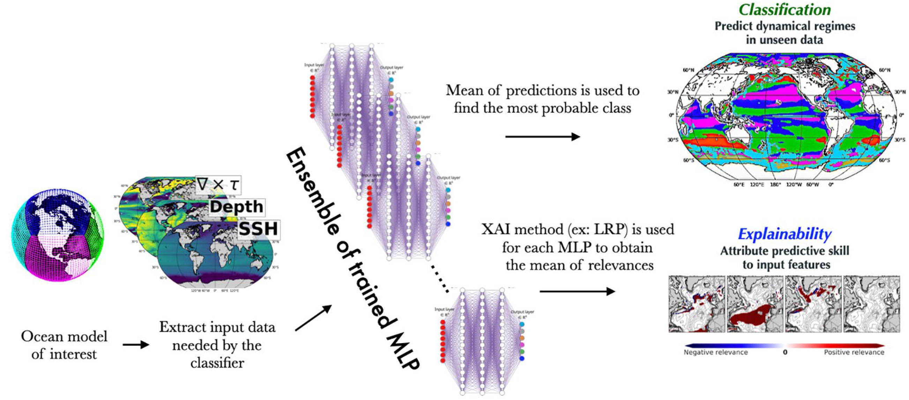

Slide 34
What is a dynamical regime?
Dynamical regime: regions with similar drivers governing circulation
A dynamical regime is a climatic regime driven by dynamical terms such as (a) the wind and bottom stress curl, (b) the advection of planetary vorticity, (c) bathymetric interactions through bottom pressure torque (BPT), (d) curl of nonlinear interactions between terms and (e) lateral viscous dissipation from within the ocean interior.

Slide 35
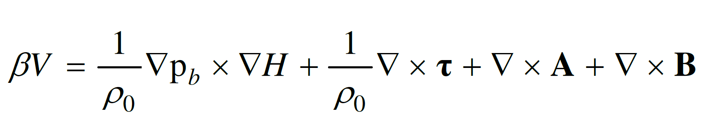
Bottom Pressure Forces
Small-scale eddies
North-South Circulation
Surface Wind Stress
Viscous Dissipation

Slide 36
Let’s pick a regime!
(Hand vote)

Slide 37
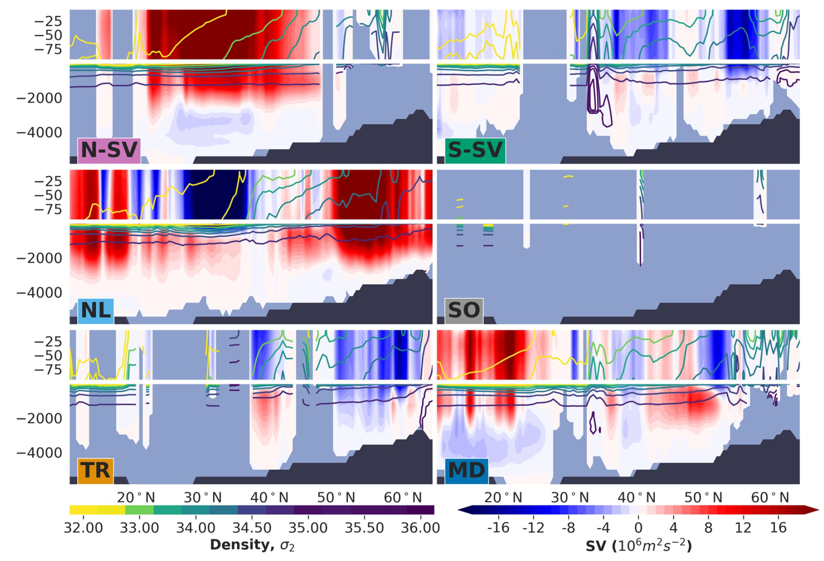
What is this dynamical regime’s vertical structure?

Slide 38
Which component(s) of the barotropic vorticity budget is most important to accurately predict that a given location is dominated by this regime?

Slide 39
Now let’s go back to the initial questions

Slide 40
